Slide 1
Object oriented programming
Iván Guerrero Román

Slide 2
Session #14
Today’s topics
4. Inheritance and polymorphism
a. Concept of inheritance
b. Access modifiers
c. Concept of polymorphism
d. Overriding and overloading
e. Abstract classes and interfaces

Slide 3
Reference and creation classes
ReferenceClass object = new CreationClass();
ReferenceClass determines the components (methods and attributes) that can be accessed with the object
CreationClass determines the object behavior (methods)
object
Created object
ReferenceClass

Slide 4
Converting objects
Definition
Converting consists in changing the reference class of an object.
Types
Implicit: It is automatically performed when you convert an object to a superclass
ParentClass object = childObject;
Explicit: Must be specified and occurs when you convert an object to a subclass
ChildClass object = (ChildClass)parentObject;
Examples
Car myCar = new Car();
Vehicle v = myCar;
Car c = (Car)v;

Slide 5
Bike
Object obj = new MountainBike();
Bike myBike = new MountainBike();
MountainBike mountain= new MountainBike();
MountainBike another;
another = (MountainBike)obj;
another = (MountainBike)myBike;
+ int numberOfMeshes
+ int gears
+ int maxSpeed
It’s possible because a mountain bike is an object
+ Nike()
+ void break()
+ void changeGear(int)
+ void changeMesh(int)
It’s possible because a mountain bike is a bike
MountainBike
Regular use
+ int chairHeight
+ MountainBike()
+ void changeHeight(int)
+ void useShockAbsorver()

Slide 6
Bike
Object obj = new MountainBike();
Bike myBike = new MountainBike();
MountainBike mountain= new MountainBike();
+ int numberOfMeshes
+ int gears
+ int maxSpeed
obj can only access the methods and attributes of the object class
+ Nike()
+ void break()
+ void changeGear(int)
+ void changeMesh(int)
myBike can only access the methods and attributes of the Bike class
MountainBike
Regular use
+ int chairHeight
+ MountainBike()
+ void changeHeight(int)
+ void useShockAbsorver()

Slide 7
Polymorphism
Ability of a method to perform different tasks according to the object in which it acts.
Allows objects with different internal structures to have the same interface.
Types of polymorphism in Java
Overload
Overwrite

Slide 8
Overload
Characteristics
Each method in java is identified by its name, type and order of its parameters
The return value type of a method does not serve to identify it
When Java encounters overloaded methods, it calls the one that best matches the parameters sent
General rules
Overloaded methods may appear in the same class or in a child class
Constructors can be overloaded
The methods must have a list of different parameters

Slide 9
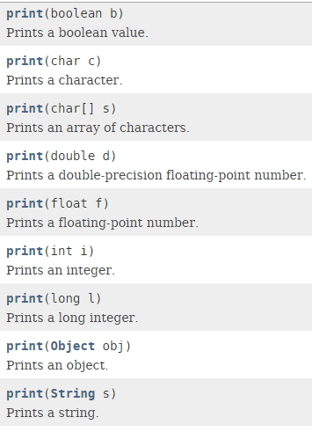
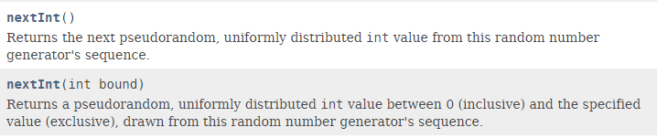
Types of overload
Methods with different number of parameters
Example: nextInt methods in the Random class
Methods with different type of parameters
Example: println method of PrintStream class
Methods with different order in their parameters
Example:
public class LoanManager {
public void loan(Client c, Material m) {
…
}
public void loan(Material m, Client c) {
…
}
}

Slide 10
Overwrite
characteristics
A child class has the same method as its parent class.
Rules
Only applicable to inherited methods
The type of a created object determines the method to be called
Constructors can not be overwritten

Slide 11
Overwriting methods
Person
Person client, provider;
client = new Client();
provider = new Provider();
client.readData();
provider.readData();
+ String name
+ String phone
+ Person( )
+ void readData()
+ void toString()
Client
Provider
+ String address
+ Date lastVisit
+ Date deliveryDate
+ Product[] products
- int counter
+ Client( )
+ void readData()
+ void toString()
+ Provider( )
+ void readData()
+ void toString()

Slide 12
Information sources
http://beginnersbook.com/2013/03/polymorphism-in-java/

Slide 13
Session #14
Today’s topics
4. Inheritance and polymorphism
a. Concept of inheritance
b. Access modifiers
c. Concept of polymorphism
d. Overriding and overloading
e. Abstract classes and interfaces

